Slide 1
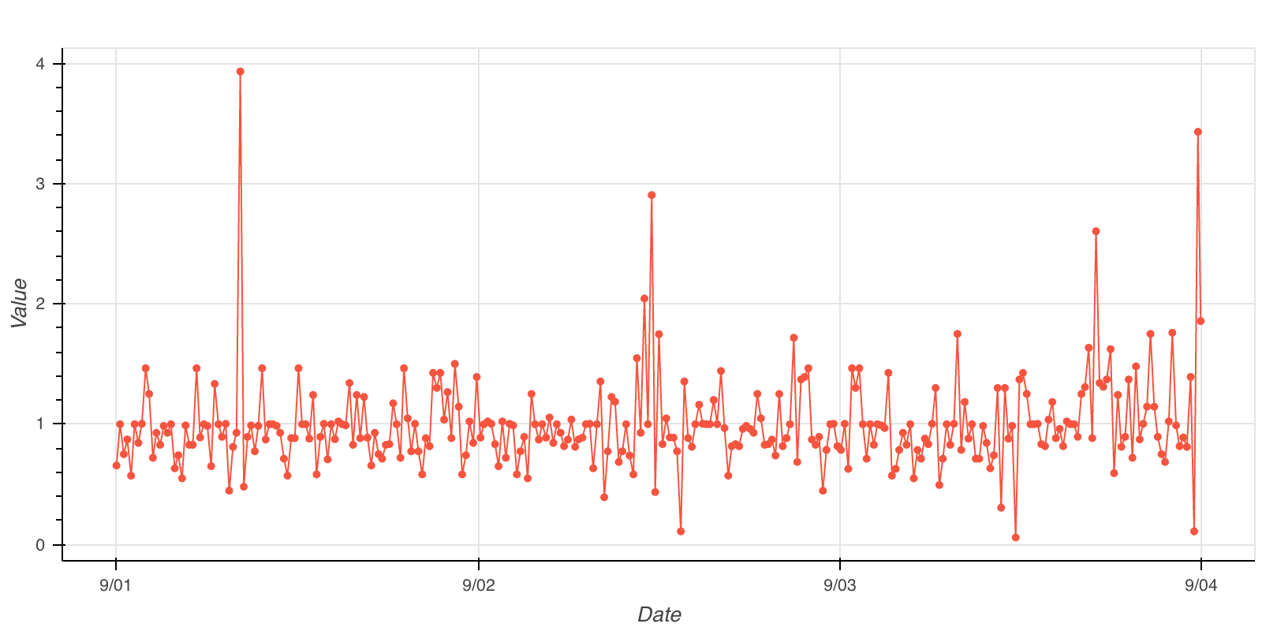
Liquidity Insights
We used average execution cost in bps for a trade of certain size, assuming no slippage, as a liquidity metric. We forecasted for a trade equal in size to 0.5% of the Average Daily Volume for the instrument
A large trade like this requires thought about execution strategy which can be optimised using the causaLens platform
We forecasted market liquidity 1min and 5min into the future and used these predictions to improve our execution strategy based on the predictions, waiting to execute if liquidity was forecasted to improve

Slide 2
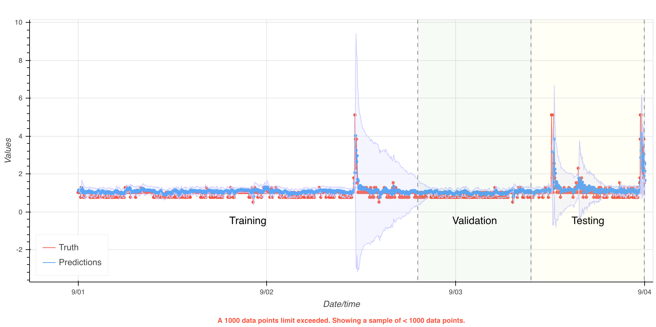
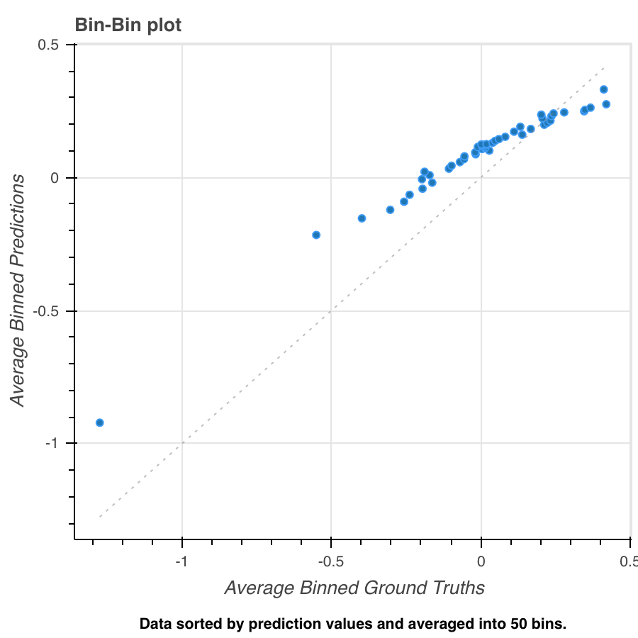
Liquidity Insights
Used 3 days of minutely Limit Orderbook snapshots to predict liquidity
Our best model predicting 5min into the future had 85% accuracy in forecasting whether liquidity would improve or disimprove in out of sample data.
Autonomously optimised over a space of ~964,449,154,047,690 models

Slide 3
Liquidity Insights
Using our strategy we achieved a 5.5% reduction in execution cost in a 1 min time interval and a 7.5% reduction over a 5min interval
Using a model trained on both targets and then using a blended strategy incorporating both predictions we were able to reduce average execution costs by 12.5%
This is a saving of 15bps on average using our execution strategy vs immediate execution which equates to $16.50 saved per contract of BTC-USD
Autonomously optimised over a space of ~964,449,154,047,690 models

